Slide 1
D-311 Unit 2: Introduction to Law Enforcement Dispatching

Slide 2
Objectives
Discuss Federal Law Enforcement missions and authorities.
List six do’s and don’ts of call taking.
Describe how to gather pertinent details for law enforcement incidents.
Describe how you can support Law Enforcement Officers during daily patrol and contacts.
Discuss different Law Enforcement incident types and prioritization.
List Dispatcher duties during emergency law enforcement situations.
Notes:
Guides and Key
The presentations and instructor guides include notes to aid facilitators in instruction.
Key
Indicates an action for the instructor to take.
Indicates topics and information for the facilitator to use as they see fit.
Example Notes
Review unit objectives.
Exercise
Advise participants that the next few slides will introduce common terms that describe parts of a fire.
Pre-Video Discussion
In this scenario, firefighters have arrived on scene of a new fire. They are gathering and communicating their situational awareness of the current fire behavior.
Play Video
Title Basic Fire Terminology
Summary State the summary
Time (02:20)
Audio
Post-Video Discussion
This unit will discuss many of these terms in more detail.
Question: Identify this fire behavior.
Answer: Torching
Note to Instructor
The fuel types listed on this slide will be discussed in detail in Unit 2.
List Level 1
List Level2
Example
Example
List Level 1
List Level 1

Slide 3
Law Enforcement Missions
Law Enforcement Agency Missions
U.S. Forest Service Law Enforcement Investigations (LEI) | Serve people and protect natural resources and property within the authority and jurisdiction of the Forest Service.
Bureau of Land Management Office of Law Enforcement and Security (OLES) | Support the Agency’s multiple-use mission by enforcing laws and regulations that advance public safety and resource protection on BLM managed public lands.
National Park Service United States Park Rangers | Work to fulfill the NPS mission by protecting the natural and cultural resources parks were established to preserve and keep people safe when they visit.
Notes:
Guides and Key
The presentations and instructor guides include notes to aid facilitators in instruction.
Key
Indicates an action for the instructor to take.
Indicates topics and information for the facilitator to use as they see fit.
Example Notes
Review unit objectives.
Exercise
Advise participants that the next few slides will introduce common terms that describe parts of a fire.
Pre-Video Discussion
In this scenario, firefighters have arrived on scene of a new fire. They are gathering and communicating their situational awareness of the current fire behavior.
Play Video
Title Basic Fire Terminology
Summary State the summary
Time (02:20)
Audio
Post-Video Discussion
This unit will discuss many of these terms in more detail.
Question: Identify this fire behavior.
Answer: Torching
Note to Instructor
The fuel types listed on this slide will be discussed in detail in Unit 2.
List Level 1
List Level2
Example
Example
List Level 1
List Level 1

Slide 4
Law Enforcement Missions
Law Enforcement Agency Missions
U.S. Fish & Wildlife Service Office of Law Enforcement (OLE) | Investigate wildlife crimes, regulate the wildlife trade, help the public understand and obey wildlife protection laws, and work in partnership with international, federal, state, local, and Tribal counterparts to conserve wildlife resources.
Bureau of Indian Affairs Office of Justice Services (OJS) | Uphold Tribal sovereignty and provide for the safety of Indian communities by ensuring the protection of life and property.
Notes:
Guides and Key
The presentations and instructor guides include notes to aid facilitators in instruction.
Key
Indicates an action for the instructor to take.
Indicates topics and information for the facilitator to use as they see fit.
Example Notes
Review unit objectives.
Exercise
Advise participants that the next few slides will introduce common terms that describe parts of a fire.
Pre-Video Discussion
In this scenario, firefighters have arrived on scene of a new fire. They are gathering and communicating their situational awareness of the current fire behavior.
Play Video
Title Basic Fire Terminology
Summary State the summary
Time (02:20)
Audio
Post-Video Discussion
This unit will discuss many of these terms in more detail.
Question: Identify this fire behavior.
Answer: Torching
Note to Instructor
The fuel types listed on this slide will be discussed in detail in Unit 2.
List Level 1
List Level2
Example
Example
List Level 1
List Level 1

Slide 5
Managing Critical Information Call Taking
Do | Don’t
Answer calls promptly | Automatically put callers on hold
Show interest | Allow distractions
Take charge | Argue
Explain holds, pauses, and delays | Fill in details or assume facts
Record information immediately | Rely on memory or recorders
End the call leaving a positive impression of your agency | Assert personal viewpoints, opinions, guesses or theories
Notes:
Guides and Key
The presentations and instructor guides include notes to aid facilitators in instruction.
Key
Indicates an action for the instructor to take.
Indicates topics and information for the facilitator to use as they see fit.
Example Notes
Review unit objectives.
Exercise
Advise participants that the next few slides will introduce common terms that describe parts of a fire.
Pre-Video Discussion
In this scenario, firefighters have arrived on scene of a new fire. They are gathering and communicating their situational awareness of the current fire behavior.
Play Video
Title Basic Fire Terminology
Summary State the summary
Time (02:20)
Audio
Post-Video Discussion
This unit will discuss many of these terms in more detail.
Question: Identify this fire behavior.
Answer: Torching
Note to Instructor
The fuel types listed on this slide will be discussed in detail in Unit 2.
List Level 1
List Level2
Example
Example
List Level 1
List Level 1

Slide 6
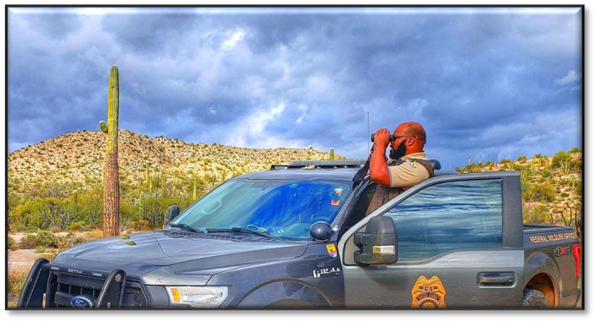
Managing Critical Information Gathering Pertinent Details
5W’s: Who, What, When, Where, How, Weapons
Where is help needed?
What is happening?
When did the event occur?
Who is involved?
How did the incident happen?
Are there any weapons?
Notes:
Guides and Key
The presentations and instructor guides include notes to aid facilitators in instruction.
Key
Indicates an action for the instructor to take.
Indicates topics and information for the facilitator to use as they see fit.
Example Notes
Review unit objectives.
Exercise
Advise participants that the next few slides will introduce common terms that describe parts of a fire.
Pre-Video Discussion
In this scenario, firefighters have arrived on scene of a new fire. They are gathering and communicating their situational awareness of the current fire behavior.
Play Video
Title Basic Fire Terminology
Summary State the summary
Time (02:20)
Audio
Post-Video Discussion
This unit will discuss many of these terms in more detail.
Question: Identify this fire behavior.
Answer: Torching
Note to Instructor
The fuel types listed on this slide will be discussed in detail in Unit 2.
List Level 1
List Level2
Example
Example
List Level 1
List Level 1

Slide 7
Managing Critical Information Descriptive Information
People | Vehicles
Name | Color
Race | Year
Sex | Make/Model
Age | Body Type
Height | Additional Info – damage, stickers, etc
Weight | License Plate State
Hair Color | License Plate Number
Clothing (top to bottom)
Notes:
Guides and Key
The presentations and instructor guides include notes to aid facilitators in instruction.
Key
Indicates an action for the instructor to take.
Indicates topics and information for the facilitator to use as they see fit.
Example Notes
Review unit objectives.
Exercise
Advise participants that the next few slides will introduce common terms that describe parts of a fire.
Pre-Video Discussion
In this scenario, firefighters have arrived on scene of a new fire. They are gathering and communicating their situational awareness of the current fire behavior.
Play Video
Title Basic Fire Terminology
Summary State the summary
Time (02:20)
Audio
Post-Video Discussion
This unit will discuss many of these terms in more detail.
Question: Identify this fire behavior.
Answer: Torching
Note to Instructor
The fuel types listed on this slide will be discussed in detail in Unit 2.
List Level 1
List Level2
Example
Example
List Level 1
List Level 1

Slide 8
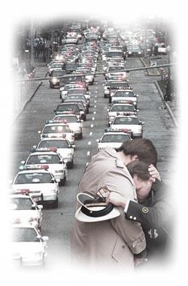
Officer Safety and Support Why it’s Important
More than 1100 Law Enforcement Officers died in the line of duty in the last 10 years; an average of one death
every 80 hours.
Line of Duty Deaths
2018: 107
2019: 89
2020: 92
2021: 129
2022: 118
Source: FBI Crime Data Report
Notes:
Guides and Key
The presentations and instructor guides include notes to aid facilitators in instruction.
Key
Indicates an action for the instructor to take.
Indicates topics and information for the facilitator to use as they see fit.
Example Notes
Review unit objectives.
Exercise
Advise participants that the next few slides will introduce common terms that describe parts of a fire.
Pre-Video Discussion
In this scenario, firefighters have arrived on scene of a new fire. They are gathering and communicating their situational awareness of the current fire behavior.
Play Video
Title Basic Fire Terminology
Summary State the summary
Time (02:20)
Audio
Post-Video Discussion
This unit will discuss many of these terms in more detail.
Question: Identify this fire behavior.
Answer: Torching
Note to Instructor
The fuel types listed on this slide will be discussed in detail in Unit 2.
List Level 1
List Level2
Example
Example
List Level 1
List Level 1

Slide 9
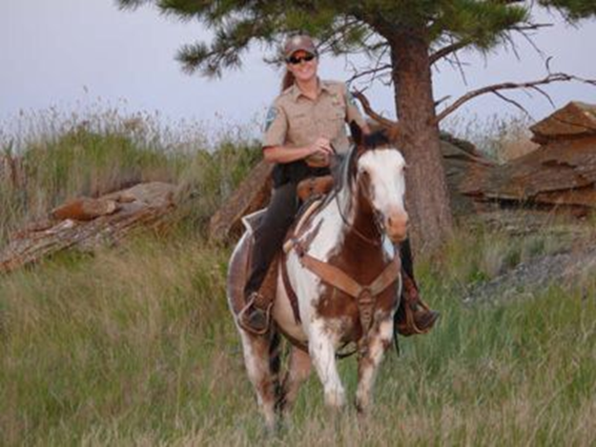
Officer Safety and Support Daily Patrol
Be situationally aware:
Which Officers are in service?
Where are they?
What are they doing?
When will they return?
Who is their closest backup and/or medical responder?
Do they require patrol status checks? (i.e. hourly/daily)
Notes:
Guides and Key
The presentations and instructor guides include notes to aid facilitators in instruction.
Key
Indicates an action for the instructor to take.
Indicates topics and information for the facilitator to use as they see fit.
Example Notes
Review unit objectives.
Exercise
Advise participants that the next few slides will introduce common terms that describe parts of a fire.
Pre-Video Discussion
In this scenario, firefighters have arrived on scene of a new fire. They are gathering and communicating their situational awareness of the current fire behavior.
Play Video
Title Basic Fire Terminology
Summary State the summary
Time (02:20)
Audio
Post-Video Discussion
This unit will discuss many of these terms in more detail.
Question: Identify this fire behavior.
Answer: Torching
Note to Instructor
The fuel types listed on this slide will be discussed in detail in Unit 2.
List Level 1
List Level2
Example
Example
List Level 1
List Level 1

Slide 10
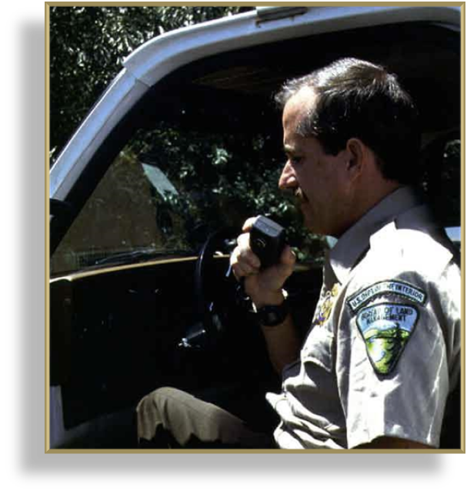
Officer Safety and Support Contacts / Traffic Stops
Law Enforcement Contact: A lawful traffic or criminal investigation, arrest, or detention or an investigatory stop by a law enforcement officer that is based on a reasonable suspicion that an offense has been or is about to be committed. (Traffic stop, Public Contact, Camp Contact, etc).
Every contact could lead to an emergency.
Always initiate status checks in accordance with office protocols.
Notes:
Guides and Key
The presentations and instructor guides include notes to aid facilitators in instruction.
Key
Indicates an action for the instructor to take.
Indicates topics and information for the facilitator to use as they see fit.
Example Notes
Review unit objectives.
Exercise
Advise participants that the next few slides will introduce common terms that describe parts of a fire.
Pre-Video Discussion
In this scenario, firefighters have arrived on scene of a new fire. They are gathering and communicating their situational awareness of the current fire behavior.
Play Video
Title Basic Fire Terminology
Summary State the summary
Time (02:20)
Audio
Post-Video Discussion
This unit will discuss many of these terms in more detail.
Question: Identify this fire behavior.
Answer: Torching
Note to Instructor
The fuel types listed on this slide will be discussed in detail in Unit 2.
List Level 1
List Level2
Example
Example
List Level 1
List Level 1

Slide 11
Officer Safety and Support Prioritizing
Examples of priority calls:
Officer requests assistance or backup
Any situation involving a hostage
Fire in an inhabited vehicle/area
Large violent gathering or major disturbance in progress
Disasters, natural or man-made
Felonies in progress where suspects are still on scene or in the area
Subject reported to be violent or mentally unstable
Notes:
Guides and Key
The presentations and instructor guides include notes to aid facilitators in instruction.
Key
Indicates an action for the instructor to take.
Indicates topics and information for the facilitator to use as they see fit.
Example Notes
Review unit objectives.
Exercise
Advise participants that the next few slides will introduce common terms that describe parts of a fire.
Pre-Video Discussion
In this scenario, firefighters have arrived on scene of a new fire. They are gathering and communicating their situational awareness of the current fire behavior.
Play Video
Title Basic Fire Terminology
Summary State the summary
Time (02:20)
Audio
Post-Video Discussion
This unit will discuss many of these terms in more detail.
Question: Identify this fire behavior.
Answer: Torching
Note to Instructor
The fuel types listed on this slide will be discussed in detail in Unit 2.
List Level 1
List Level2
Example
Example
List Level 1
List Level 1

Slide 12
Officer Safety and Support Prioritizing
Examples of priority calls:
Disturbance with a weapon involved
Serious injury as a resulting from a crime
Officer must clear the advance of medical units.
Notes:
Guides and Key
The presentations and instructor guides include notes to aid facilitators in instruction.
Key
Indicates an action for the instructor to take.
Indicates topics and information for the facilitator to use as they see fit.
Example Notes
Review unit objectives.
Exercise
Advise participants that the next few slides will introduce common terms that describe parts of a fire.
Pre-Video Discussion
In this scenario, firefighters have arrived on scene of a new fire. They are gathering and communicating their situational awareness of the current fire behavior.
Play Video
Title Basic Fire Terminology
Summary State the summary
Time (02:20)
Audio
Post-Video Discussion
This unit will discuss many of these terms in more detail.
Question: Identify this fire behavior.
Answer: Torching
Note to Instructor
The fuel types listed on this slide will be discussed in detail in Unit 2.
List Level 1
List Level2
Example
Example
List Level 1
List Level 1

Slide 13
Officer Safety and Support Increased Risk Incidents
Low frequency/high risk incidents
Arrest
Officer down
Shootings
Officer involved
Active shooter
Taser deployment
Backup/cover
Pursuit
Riots
Notes:
Guides and Key
The presentations and instructor guides include notes to aid facilitators in instruction.
Key
Indicates an action for the instructor to take.
Indicates topics and information for the facilitator to use as they see fit.
Example Notes
Review unit objectives.
Exercise
Advise participants that the next few slides will introduce common terms that describe parts of a fire.
Pre-Video Discussion
In this scenario, firefighters have arrived on scene of a new fire. They are gathering and communicating their situational awareness of the current fire behavior.
Play Video
Title Basic Fire Terminology
Summary State the summary
Time (02:20)
Audio
Post-Video Discussion
This unit will discuss many of these terms in more detail.
Question: Identify this fire behavior.
Answer: Torching
Note to Instructor
The fuel types listed on this slide will be discussed in detail in Unit 2.
List Level 1
List Level2
Example
Example
List Level 1
List Level 1

Slide 14
Officer Safety and Support Contacts / Traffic Stops
The following should be done for every contact:
Where: Find the Officer’s location on a map.
Who: Who are you going to send if backup is requested?
How: Do you need to provide backup units with directions?
Don’t wait for the backup request before compiling this information; time is critical at this point.
Notes:
Guides and Key
The presentations and instructor guides include notes to aid facilitators in instruction.
Key
Indicates an action for the instructor to take.
Indicates topics and information for the facilitator to use as they see fit.
Example Notes
Review unit objectives.
Exercise
Advise participants that the next few slides will introduce common terms that describe parts of a fire.
Pre-Video Discussion
In this scenario, firefighters have arrived on scene of a new fire. They are gathering and communicating their situational awareness of the current fire behavior.
Play Video
Title Basic Fire Terminology
Summary State the summary
Time (02:20)
Audio
Post-Video Discussion
This unit will discuss many of these terms in more detail.
Question: Identify this fire behavior.
Answer: Torching
Note to Instructor
The fuel types listed on this slide will be discussed in detail in Unit 2.
List Level 1
List Level2
Example
Example
List Level 1
List Level 1

Slide 15
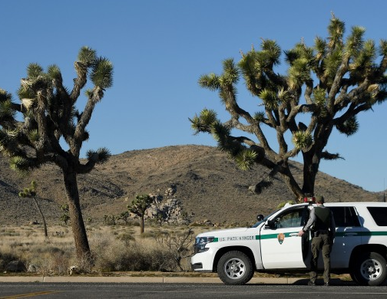
Officer Safety and Support Contacts / Traffic stops
Radio Location/Direction of Travel
Ex: “Southbound Park Blvd at Jumbo Rocks Campground”
Give vehicle description
License Number
Make & Color
Number of Occupants
Notes:
Guides and Key
The presentations and instructor guides include notes to aid facilitators in instruction.
Key
Indicates an action for the instructor to take.
Indicates topics and information for the facilitator to use as they see fit.
Example Notes
Review unit objectives.
Exercise
Advise participants that the next few slides will introduce common terms that describe parts of a fire.
Pre-Video Discussion
In this scenario, firefighters have arrived on scene of a new fire. They are gathering and communicating their situational awareness of the current fire behavior.
Play Video
Title Basic Fire Terminology
Summary State the summary
Time (02:20)
Audio
Post-Video Discussion
This unit will discuss many of these terms in more detail.
Question: Identify this fire behavior.
Answer: Torching
Note to Instructor
The fuel types listed on this slide will be discussed in detail in Unit 2.
List Level 1
List Level2
Example
Example
List Level 1
List Level 1

Slide 16
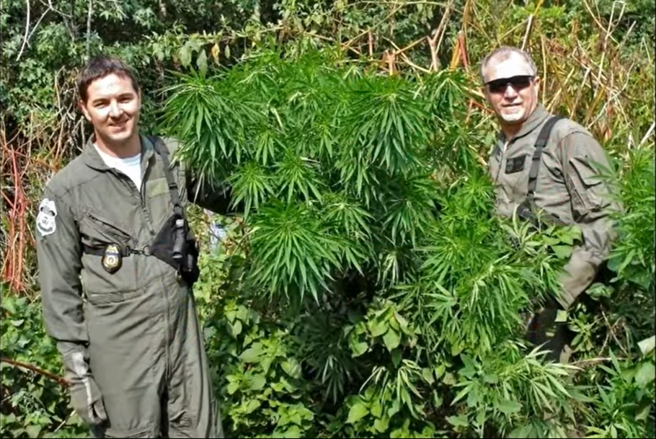
Officer Safety and Support Contact Status Checks
Every center should have a contact status check policy.
ECCs will initiate an automatic status timer during all law enforcement contacts.
Continue with status checks until the Officer clears or discontinues.
If the Officer fails to answer status, send backup following local procedures.
Notes:
Guides and Key
The presentations and instructor guides include notes to aid facilitators in instruction.
Key
Indicates an action for the instructor to take.
Indicates topics and information for the facilitator to use as they see fit.
Example Notes
Review unit objectives.
Exercise
Advise participants that the next few slides will introduce common terms that describe parts of a fire.
Pre-Video Discussion
In this scenario, firefighters have arrived on scene of a new fire. They are gathering and communicating their situational awareness of the current fire behavior.
Play Video
Title Basic Fire Terminology
Summary State the summary
Time (02:20)
Audio
Post-Video Discussion
This unit will discuss many of these terms in more detail.
Question: Identify this fire behavior.
Answer: Torching
Note to Instructor
The fuel types listed on this slide will be discussed in detail in Unit 2.
List Level 1
List Level2
Example
Example
List Level 1
List Level 1

Slide 17
Officer Safety and Support Restricting Traffic
You should restrict traffic when:
An Officer advises there is an emergency/emergency traffic.
An Officer advises they need help
Other routine traffic is interfering with a law enforcement contact.
An Officer is making an arrest (check your local policy).
Notes:
Guides and Key
The presentations and instructor guides include notes to aid facilitators in instruction.
Key
Indicates an action for the instructor to take.
Indicates topics and information for the facilitator to use as they see fit.
Example Notes
Review unit objectives.
Exercise
Advise participants that the next few slides will introduce common terms that describe parts of a fire.
Pre-Video Discussion
In this scenario, firefighters have arrived on scene of a new fire. They are gathering and communicating their situational awareness of the current fire behavior.
Play Video
Title Basic Fire Terminology
Summary State the summary
Time (02:20)
Audio
Post-Video Discussion
This unit will discuss many of these terms in more detail.
Question: Identify this fire behavior.
Answer: Torching
Note to Instructor
The fuel types listed on this slide will be discussed in detail in Unit 2.
List Level 1
List Level2
Example
Example
List Level 1
List Level 1

Slide 18
Summary
Discuss Federal Law Enforcement missions, authorities, and jurisdiction.
List six do’s and don’ts of call taking.
Describe how to gather pertinent details for law enforcement incidents.
Describe how you can support Law Enforcement Officers during daily patrol and contacts.
Discuss different Law Enforcement incident types and prioritization.
List Dispatcher duties during emergency law enforcement situations.
Notes:
Guides and Key
The presentations and instructor guides include notes to aid facilitators in instruction.
Key
Indicates an action for the instructor to take.
Indicates topics and information for the facilitator to use as they see fit.
Example Notes
Review unit objectives.
Exercise
Advise participants that the next few slides will introduce common terms that describe parts of a fire.
Pre-Video Discussion
In this scenario, firefighters have arrived on scene of a new fire. They are gathering and communicating their situational awareness of the current fire behavior.
Play Video
Title Basic Fire Terminology
Summary State the summary
Time (02:20)
Audio
Post-Video Discussion
This unit will discuss many of these terms in more detail.
Question: Identify this fire behavior.
Answer: Torching
Note to Instructor
The fuel types listed on this slide will be discussed in detail in Unit 2.
List Level 1
List Level2
Example
Example
List Level 1
List Level 1

